Slide 1

NDMA CUAS Specialist Course
Boresighting and Sensor Alignment

Slide 2

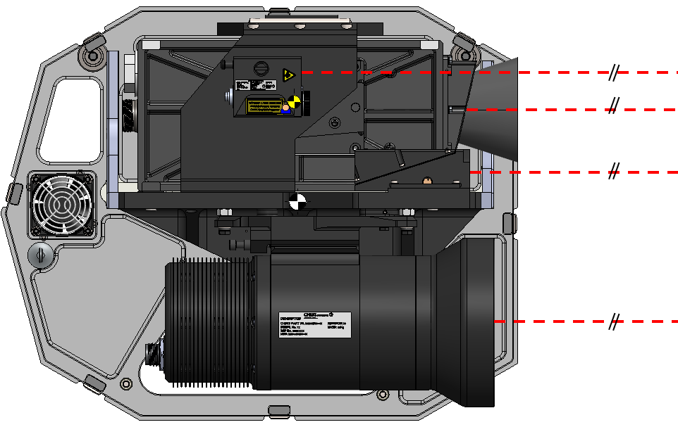
Sensor Alignment – Boresighting Principal
Boresighting Principles
To achieve full system performance several alignment procedures need to be undertaken on the CUAS system.
The aim of the boresighting procedure is to align the sensors so that the optical centre beams are parallel to each other. This provides the most accurate alignment of the sensors over long ranges.

Slide 3
Sensor Alignment – Boresighting Top-Level Process
These activities should be carried out in the specific order listed below for the most accurate alignment result.
The TV Camera is the fixed sensor and is therefore the reference to align the other sensors to.
Mechanical Alignment should be carried out to a target at >=2.5Km
Note: These are only approximate distances
  Enter Alignment screen (Shift X)
  Select for TV Camera to be visible with the LRF.
    Check alignment of the LRF to the daylight TV camera.
    If required, perform mechanical (coarse) alignment of the LRF to the centre of the daylight TV camera.
  Select the TI Camera to be visible with the LRF.
    Check alignment of the TI camera to the daylight TV camera.
    Perform mechanical (coarse) alignment of the TI to be at the centre of the daylight TV camera.
  Perform digital (fine) alignment of daylight TV and TI cameras.
  Exit alignment screen

Slide 4
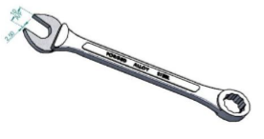
Sensor Alignment - Tooling
Tools required for Alignment
Thinned down 12 A/F spanner (Part No. 1933-0000-T02)
8mm / 10mm / 13mm / 14mm AF Spanners
2mm Hex Key

Slide 5
Sensor Alignment – Mechanical Boresight Procedure
Important Notes
NOTE: The daylight TV camera mechanical installation is fixed and does not have mechanical adjustment for boresighting.
NOTE: The LRF is mounted to a dovetail that allows small mechanical movements in azimuth and elevation.
NOTE: The TI camera is mounted to a dovetail that allows small mechanical movements in azimuth and elevation.
NOTE: Chess Dynamics recommend a digital boresight adjustment of less than 100px.
Preparation
  Step 1. Ensure that the mounting bolts of the daylight TV camera, TI camera, LRF, and the laser pointer are tightened correctly.
  Step 2. On the VMS, Shift X to enter the boresight alignment screen.
  Step 3. Set the digital boresight crosshair values in the VMS to 0.0 for the daylight TV and TI cameras using the ‘Zero’ and ‘Apply’ buttons.
Check LRF boresight to the TV camera
  Step 1. Set the boresight alignment screen to display video feeds for the daylight TV camera and the LRF.
  Step 2. Move the system to aim at a distant object >2km away and verify that the daylight TV camera and the LRF crosshairs are coarsely aligned.
  If not, perform mechanical alignment the LRF to the daylight TV camera.

Slide 6
Sensor Alignment – LRF Mechanical Boresight Procedure
Coarse alignment of the LRF
  Using an 8mm A/F spanner, loosen the elevation locking screw, to allow the movement, and use a 10mm A/F spanner to loosen the three azimuth locking screws.
  Using a 14mm A/F spanner, adjust the elevation adjustment cam to adjust the LRF in elevation. Make small adjustments whilst observing the boresight elevation between the daylight TV and LRF camera on the display until elevation alignment is coarsely achieved.
  With the thin 12mm A/F spanner, use the 4 azimuth adjustment feet to adjust the LRF azimuth boresight whilst observing the boresight azimuth alignment between the TV camera and the LRF on the display until azimuth alignment is coarsely achieved.
    To avoid ‘twisting’ of the sensor, make equal and small adjustments between the 2 adjustment feet at the front or the rear.
  Once coarsely aligned between the TV camera and the LRF in both azimuth and elevation, tighten up the elevation locking screw and the four azimuth locking screws.

Slide 7
Sensor Alignment – Mechanical Boresight Procedure
Check TI camera boresight to the daylight TV
  Step 1. Set the boresight alignment screen to display video feeds for the daylight TV camera and the TI.
  Step 2. Move the system to aim at a distant object >2km away and verify that the daylight TV camera and the TI crosshairs are coarsely aligned.
  If not, perform mechanical alignment of the TI to the daylight TV camera.

Slide 8
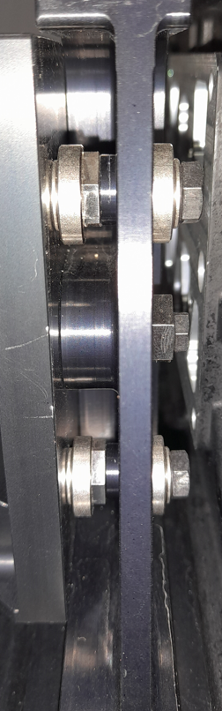
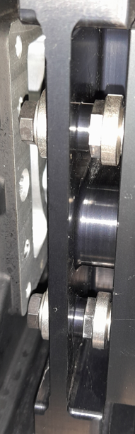
Sensor Alignment – LRF Mechanical Boresight Adjustment Locations
12mm Azimuth Front Adjustment
10mm Azimuth Lock Screw
10mm Azimuth Lock Screw
8mm Elevation Lock Screw
12mm Azimuth Rear Adjustment
14mm Elevation Adjustment
10mm Azimuth Lock Screw
10mm Azimuth Lock Screw
12mm Azimuth Front Adjustment
12mm Azimuth Rear Adjustment

Slide 9
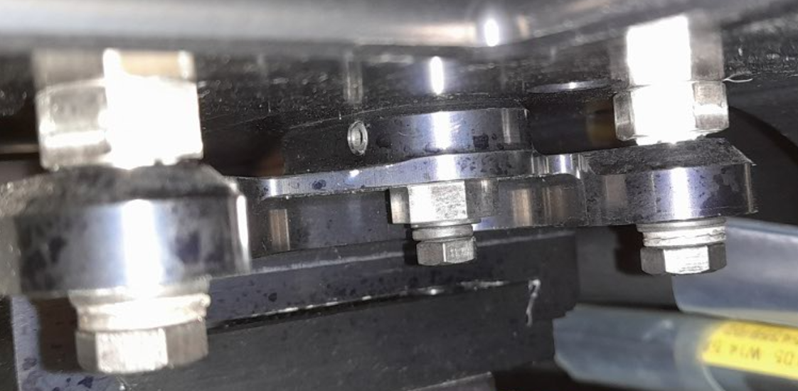
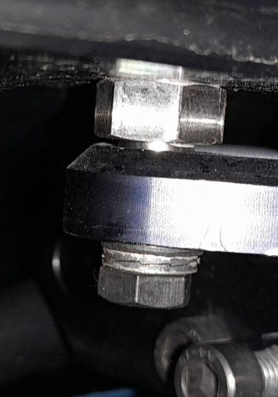
Sensor Alignment – TI Mechanical Boresight Adjustment Locations
13mm Elevation rear adjustment
10mm Elevation locking screw
8mm Azimuth locking screw
10mm Elevation locking screw
10mm Elevation locking screw
2mm hex Azimuth locking grub screw
13mm Azimuth adjustment
13mm Elevation front adjustment
13mm Elevation front adjustment

Slide 10
Sensor Alignment – TI Mechanical Boresight Procedure
Coarse alignment of the TI camera
  Using an 8mm A/F spanner, loosen the azimuth locking screw, to allow the movement, and use a 10mm A/F spanner to loosen the three elevation locking screws.
  Use a 2mm hex key to back off the azimuth adjuster cam grub screw.
  With a 13mm A/F spanner, use the cam to adjust the TI camera azimuth boresight. Make small adjustments whilst observing the boresight azimuth alignment between the TI camera and the LRF on the display until elevation alignment is coarsely achieved.
  Using a 13mm A/F spanner, adjust the three elevation adjustment feet to adjust the camera in elevation. Make small adjustments whilst observing the boresight elevation between the daylight TV and TI cameras on the display until elevation alignment is coarsely achieved.
  Once coarsely aligned between the TI camera and the LRF in both azimuth and elevation, tighten up the azimuth adjuster cam grub screw, the azimuth locking screw and the three elevation locking screws.

Slide 11
Sensor Alignment – TV/TI Digital Boresight Procedure
NOTE: Ensure the TI camera has been coarsely aligned before starting the digital boresight procedure.
  On the VMS screen, press Shift X to enter the boresight alignment screen.
  Set the alignment boresight screen to display video feeds for the daylight TV camera and the LRF.
  Move the system to precisely centre the LRF crosshair on a distant object >2km away.
  Press the + button to zoom in to the narrowest FOV. Press the HC Mode button to change the hand controller from normal platform moving mode in manual, to moving the crosshair boresight of the selected sensor. Adjust crosshairs onto the target. The button will change to yellow when pressed.
  Press the - button to zoom out to the widest FOV. Press the HC mode button, adjust and then press the HC Mode button again.
  From the drop-down, select the TI camera and repeat steps 4 to 5.
  Press Exit to return to the main screen.
  Switch between the cameras and LRF video to verify that the boresight crosshairs are all precisely aligned. Zoom in and out to ensure that the cross hairs are aligned on a single point. If necessary, restart the digital boresight procedure.

Slide 12

Sensor Alignment – LRF Beam Divergence
NOTE: The opening at the centre of the LRF crosshair is a visual representation the beam divergence and cannot be adjusted.
LRF beam divergence

Slide 13
Sensor Alignment – Image Fusion Alignment Procedure
Procedure
  On the VMS, press Fusion (F15) to enter the image fusion alignment screen.
  Press Align (F14) to display the image fusion controls.
  Aim the cameras at a scene where the video from the daylight TV and TI cameras is clear. They will automatically drive to the first fixed field of view.
  Use the onscreen controls to align the daylight TV and TI camera images for the selected field of view.
  Repeat the image fusion alignment for the remaining fields of view.
  Press Apply to save the alignment settings.
  Press Reset to return to the previously saved or default settings.
  Press Exit to leave image fusion alignment.

Slide 14
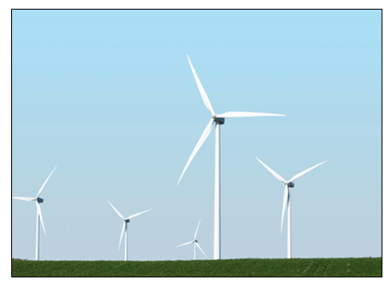
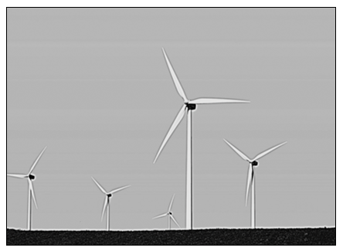
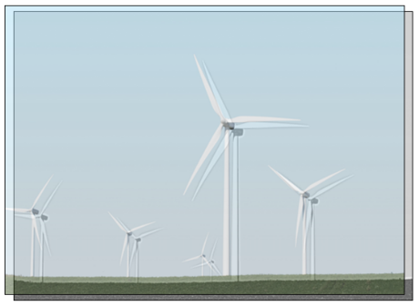
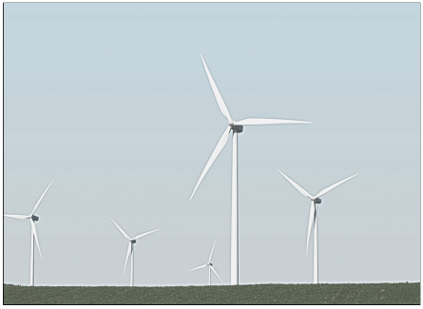
Sensor Alignment – Image Fusion Alignment Procedure
TV Camera Image
TI Camera Image
Fused Image - Unaligned
Fused Image - Aligned

Slide 15
Sensor Alignment
Practical Session on System Alignment

